Slide 1
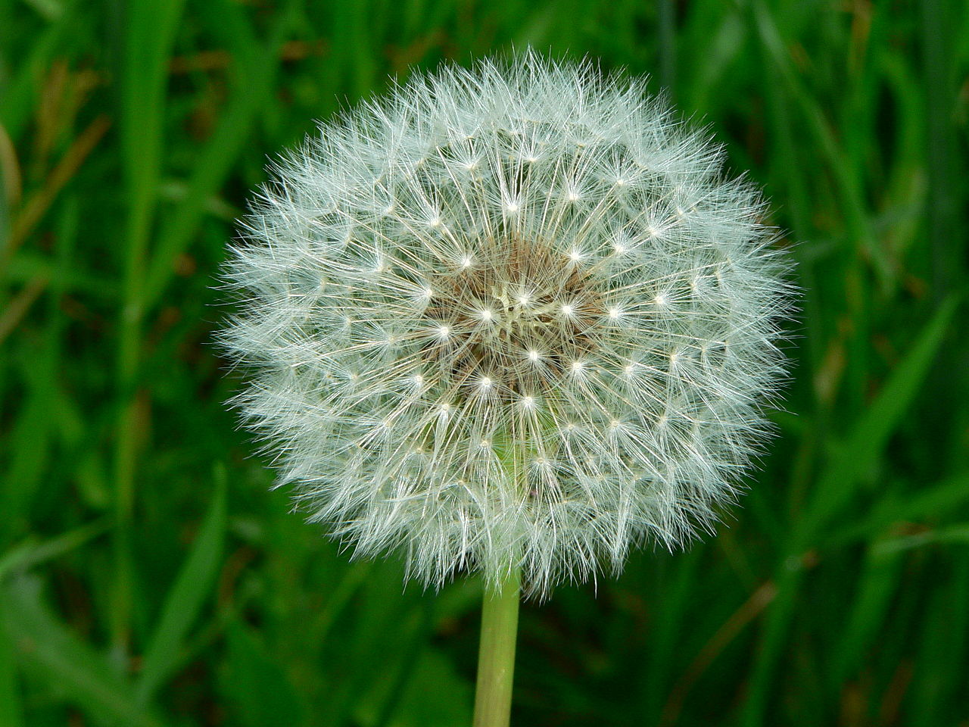
Plant Name Here Latin Name Here
Other common names:
...
Growth Habitat
perennial, annual, tree, shrub?
Hardiness zone: (HPAGC Zone is primarily 6b)

Slide 2
Weed Name Here
Characteristics:
Height: Width:
Bloom colour:
Bloom fragrance:
Bloom time:
Other details: shade tolerance, disease resistance, seasonal interest?
Leaf: size, shape, colour?
Light: grows best in full sun, part sun, part shade, full shade?

Slide 3
Plant Name Here
Water: requires watering, drought tolerant, tolerates wet ground, etc?Where: in what conditions on your property does it do best?
Special Care: does it require special treatment to grow well in your garden?
Why I love this plant:
Where to buy this plant:

