Slide 1
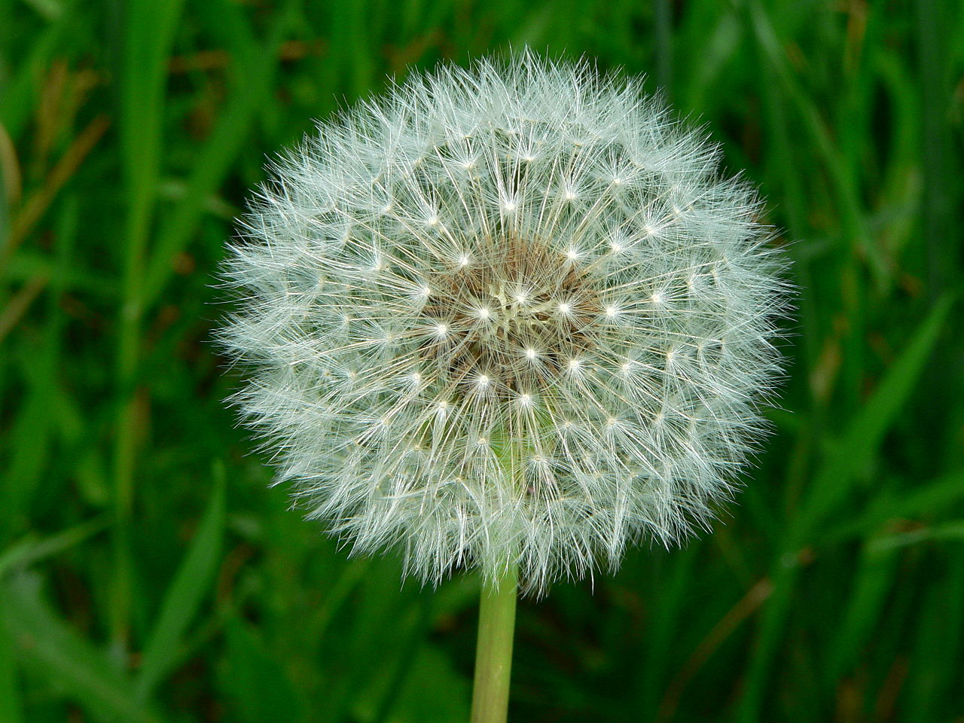
Weed Name Here
Latin Name Here
Other common names:
  ...
Seasons:
  When present in NS
Stages of life:
  Adult, larvae, etc.
Natural predators or prey:
  Birds, aphids, etc.
Here, put a text description of how one identifies the weed: leaves, stripes, spots, colours, distinguishing features, and so on.

Slide 2
Weed Name Here
Habitat
  Soil types and conditions, moisture, light preferences
Season
  ...
Why is it considered a weed?
  ...
Does it have any benefits?
  ...
How can it be controlled
  ...

